Slide 1
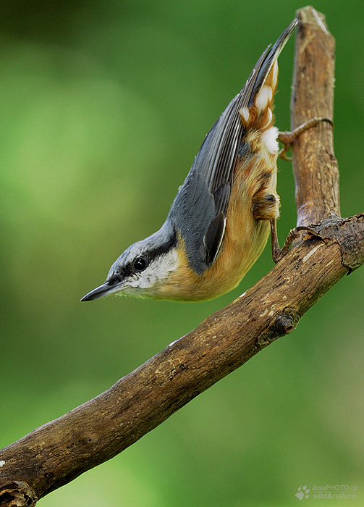

RTRIM-shell tutorial
Eva Šilarová
silarova@birdlife.cz

Slide 2
RTRIM-shell Introduction
Introduction
Reason: whole indicator calculation process update
Advantages:
  Available as a package
  Simplification – easy to use in R, easy to run many times once it works
Updates:
Improved the data preparation for RTRIM-shell
  Will be introduced at the Webinar
  Download newest version of RTRIM-shell:
  https://pecbms.info/methods/software/trim/
Updated ONLT for RTRIM-shell outputs
  https://data.pecbms.info/user/login
RTRIM-shell Forum
  Will be introduced at the Webinar
  Various topics will be discussed on one spot and newest versions of programs will be available

Slide 3
RTRIM-shell Introduction
Introduction
Reason: whole indicator calculation process update
Advantages:
  Available as a package
  Simplification – easy to use in R, easy to run many times once it works
Updates:
Improved the data preparation for RTRIM-shell
  Will be introduced at the Webinar
  Download newest version of RTRIM-shell:
  https://pecbms.info/methods/software/trim/
Updated ONLT for RTRIM-shell outputs
  https://data.pecbms.info/user/login
RTRIM-shell Forum
  Will be introduced at the Webinar
  Various topics will be discussed on one spot and newest versions of programs will be available

Slide 4
Be aware
Introduction
Content and format of the files, which YOU send to PECBMS, MUST BE EXACTLY THE SAME AS THE ONE CREATED BY the RTRIM-shell!!!!
Not allowed to change the RTRIM-shell code for data analyses
  Inform me if you find a mistake
Do not add any covariates
  RTRIM-shell does not enable to run models with covariates, as RTRIM does.
  Reason: unification of analyses for all the countries.

Slide 5
Important change in attitude
Introduction
TRIM
= 1 rigid program for 20 years without changes
RTRIM-shell
= 1 R script for RTRIM-shell + possible additional scripts
=> Changes in time enabling fast reactions and program improvement
Program will be improved and adjusted by anybody
=> good to follow the Forum, where all news will be discussed and explained
  Agree with authomatic Email reminders informing about new post in Forum
Newest updated version will be sent together with recent data request
RTRIM-shell and On-line tool Tutorials yearly update
  Recent RTRIM-shell script
    If you improve any of scripts, your version will be always 0.1 higher than the former one
    => downloaded script RTRIM-shell_v1.2 -> Improved version = RTRIM-shell_v1.3

Slide 6
Important change in attitude
Introduction
TRIM
= 1 rigid program for 20 years without changes
RTRIM-shell
= 1 R script for RTRIM-shell + possible additional scripts
=> Changes in time enabling fast reactions and program improvement
Program will be improved and adjusted by anybody
=> good to follow the Forum, where all news will be discussed and explained
  Agree with authomatic Email reminders informing about new post in Forum
Newest updated version will be sent together with recent data request
RTRIM-shell and On-line tool Tutorials yearly update
  Recent RTRIM-shell script
    If you improve any of scripts, your version will be always 0.1 higher than the former one
    => downloaded script RTRIM-shell_v1.2 -> Improved version = RTRIM-shell_v1.3

Slide 7
PECBMS forum
Introduction
Communication portal for PECBMS community
  Couple of forums for RTRIM-shell, On-line tools, Site-level data,…
  Forum for one big topic with couple of subforums
  Example:
    RTRIM-shell forum contains subforums:
      Tutorial
      Data preparation
      RTRIM-shell script improvements
Main administrator: Eva Silarova
Will be introduced at PECBMS Webinar

Slide 8
RTRIM-shell Webinar
Introduction
On Tuesday 30.3. at 10-12 am CET
Topic: RTRIM-shell webinar (Eva)
Time: Mar 30, 2021 10:00 Prague Bratislava
Join Zoom Meeting
https://us02web.zoom.us/j/85793250178?pwd=OWc1NFp4YWVhT20xOHNabFk2TGR0dz09
Meeting ID: 857 9325 0178
Passcode: 364857
What to do before webinar:
Run example files
Run RTRIM-shell with your own data
  Start with 2-3 most common species
  Copy the example files and fill it with your own data.
  Run RTRIM-shell
  Contact me in case of problems

Slide 9
RTRIM-shell Procedure
Introduction
Create a working_folder
Input files
RTRIM-shell scripts
Downloading R and RTRIM
Output files
Output correction and submission
RTRIM-shell examples
R for beginners

Slide 10
RTRIM-shell Procedure
Introduction
Create a working_folder
Input files
RTRIM-shell scripts
Downloading R and RTRIM
Output files
Output correction and submission
RTRIM-shell examples
R for beginners

Slide 11
1. Create a working_folder
Data preparation
USE ALL THE NAMES WITHOUT SPACES, PLEASE
  working_folder or working-folder
Your working folder must contain:
working_folder
BMP_18570_1_4_counts.csv
BMP_18570_1_4_arg_input_stratum.csv
shell_rtrim_strata.R script
processingOutputSpeciesStratumCombinations.R script
functions_Shell_Rtrim.R script

Slide 12
2. Input files
Data preparation
Two .csv tables for each species
1) BMP_18570_1_4_counts.csv
= your data file
2) BMP_18570_1_4_arg_input_stratum.csv
= file with arguments => “cooking book”
- information to analyse the counts e.g.
- overdispersion, serial correlation, …

Slide 13
2. What does the name of input file mean?
Data preparation
BMP_18570_1_4_counts.csv
BMP = code for bird
  will be deleted before data submitting
  you can choose you own code
_18570 = euring species code
_1 = national data
  use always 1 in case of data sent to the PECBMS unit
_ 4 = country code

Slide 14
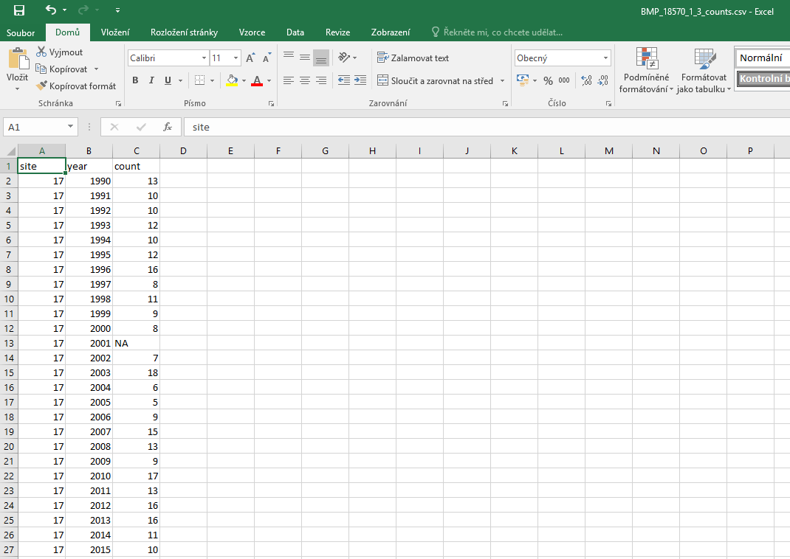
Data preparation
2.
BMP_18570_1_4_counts.csv
site | year | count
17 | 1990 | 13
17 | 1991 | 10
17 | 1992 | 10
17 | 1993 | NA
… | … | …
22 | 1990 | 7
22 | 1991 | 5
weights
Weights may also be present in this file.
!!! If no weights are used
-> don't include the column Weights
in the table!
"NA" for missing values instead of -1

Slide 15
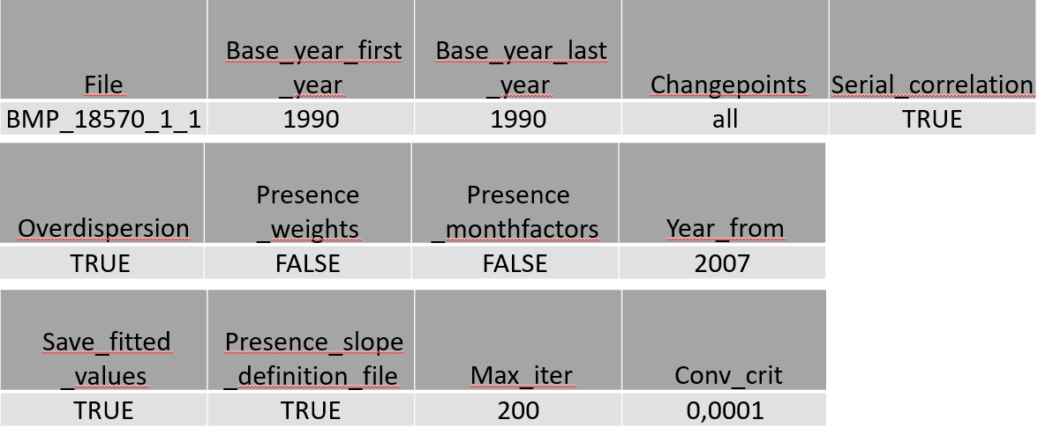
BMP_18570_1_4_arg_input_stratum.csv
2.
Data preparation
4
Information how to analyse the counts

Slide 16
Data preparation
BMP_18570_1_4_arg_input_stratum.csv
2.
4
Information how to analyse the counts

Slide 17
3. RTRIM-shell scripts
RTRIM-shell
  Save all 3 R scripts into your working_folder
  Detailed manual is right in the scripts
  1) shell_rtrim_strata.R script
  = Shell RTRIM
  - Start with this script
  - Produces an Overview of successful runs + Rdata file for each RTRIM analysis
  2) processingOutputSpeciesStratumCombinations.R script
  = Processing output of RTRIM shell
  - Run this script as second
- Delivers outputfiles right in your working_folder
3) functions_Shell_Rtrim.R script
= Supporting functions for the other scripts
=> You do nothing with this script – R uses it by itself

Slide 18
3. R Script preparations
RTRIM-shell
Same preparation for both R scripts:
1) shell_rtrim_strata.R
2) processingOutputSpeciesStratumCombinations.R
Set path to the script with functions
source("D:/working_folder/functions_Shell_Rtrim.R")
Set path to your working_folder
folder <- "D:/working_folder/" # !! user dependent!!

Slide 19
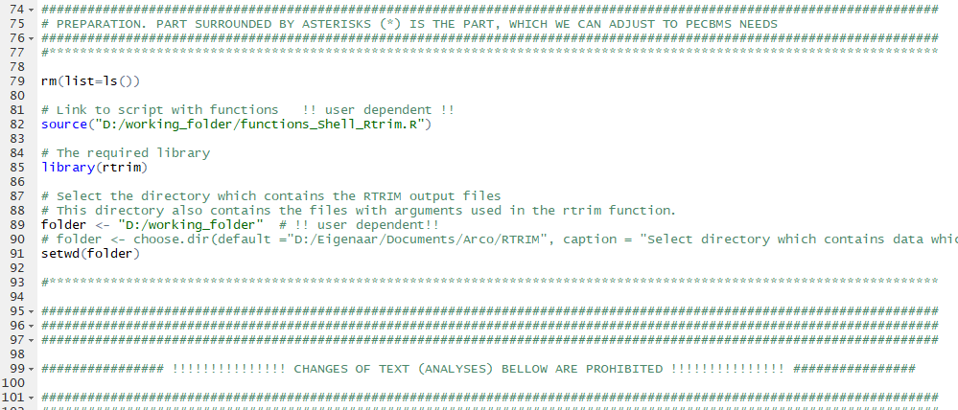
3. R Script preparations
RTRIM-shell

Slide 20
4. Download R and RTRIM if needed
RTRIM-shell
More detailed information about R and RStudio is at the end of presentation
  In part called R for beginners
Let’s run the RTRIM-shell analyses!

Slide 21
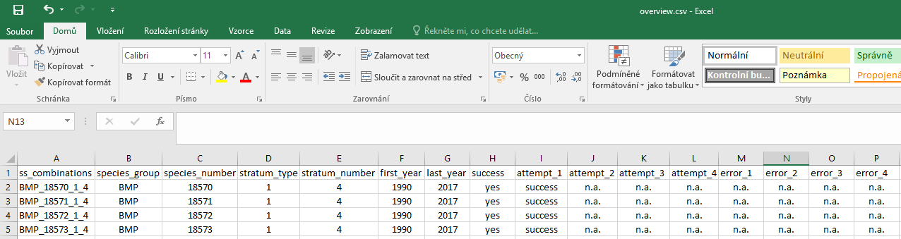
5. Overview
RTRIM-shell
Check the Overview, which was saved in your working_folder
The second script processingOutputSpeciesStratumCombinations.R
uses Overview to process output of RTRIM shell
If successful analyses -> open and run the script processingOutputSpeciesStratumCombinations.R

Slide 22
5. Output files from RTRIM-shell analyses
RTRIM-shell
Your output – “6” files with different results
BMP_18570_1_4_indices_TT.csv (indices and time totals)
BMP_18570_1_4_ocv.csv (variances and year-year covariances)
BMP_18570_1_4_arg_output.csv (overdispersion, serial correlation, overall slope etc.)
BMP_18570_1_4_fitted_values.csv (fitted values)
Overview.csv
all_Indices_All_Trends.csv
  Particular results of your analyses

Slide 23
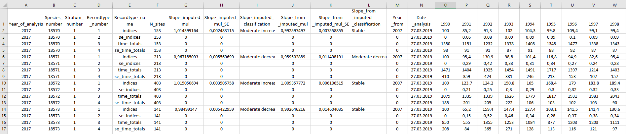
5. Output file „all_Indices_All_Trends.csv“
RTRIM-shell

Slide 24
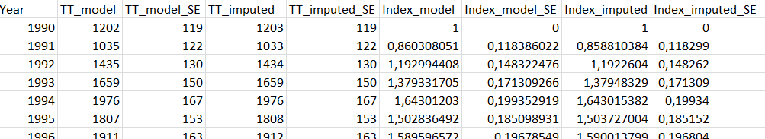
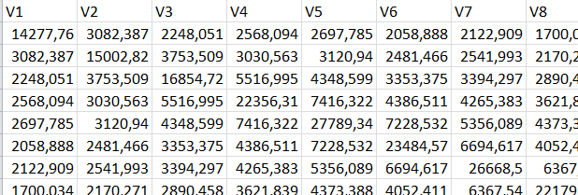
5. Output files to be submitted
This is exact form of files!!!!!!!!!!!!!!!!!!
RTRIM-shell
_Indices_TT.csv
(indices and time totals)
_ocv.csv
(variances and year-year covariances)
_arg_output.csv
(overdispersion, serial correlation,
overall slope etc.)

Slide 25
6. All Output files from RTRIM-shell analyses shall be submitted
  Data delivery
Your output – “6” files with different results
BMP_18570_1_4_indices_TT.csv (indices and time totals)
BMP_18570_1_4_ocv.csv (variances and year-year covariances)
BMP_18570_1_4_arg_output.csv (overdispersion, serial correlation, overall slope etc.)
BMP_18570_1_4_fitted_values.csv (fitted values)
Overview.csv
all_Indices_All_Trends.csv
  Particular results of your analyses
Monitoring_scheme_{country_code}.xlsx

Slide 26
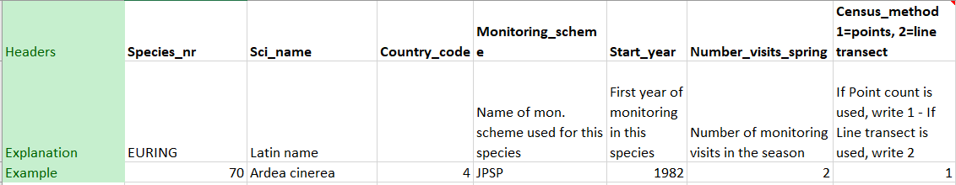
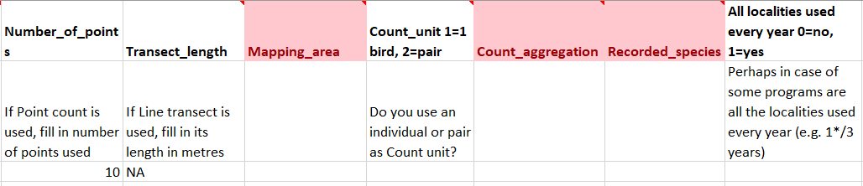
Monitoring_scheme_{country_code}.xlsx
  Data delivery
Serves as transparent overview of monitoring schemes
  each species in each country and scheme basic description
Uploaded by national coordinator to the On-line tool
Uniform design
Not finished yet -> Will be delivered together with the data request

Slide 27
  Data delivery
6. Data modification before upload to On-line tool
DO NOT OPEN THE FILES TO BE SUBMITTED TO THE PECBMS UNIT!!!!!
  computer might change the formatting of .csv tables
Copy working_folder with all the data received from RTRIM-shell
Rename copy of the working_folder to „Country_final year“ in the dataset
-> e.g. Austria_2025
Delete the Input files
Remove prefix in Output files
Add table Monitoring_scheme_{country_code}.xlsx
Zip the folder
Upload whole zipped folder in the ONLT

Slide 28
  Data delivery
6. Output files to be submitted
Prefix “BMP_= Bird Monitoring Program” (Or “BIRD_” or whatever) should be deleted
Euringcode_1_country_indices_TT.csv => 18570_1_4_indices_TT.csv
Euringcode_1_country_ocv.csv => 18570_1_4_ocv.csv
Euringcode_1_country_arg_output.csv => 18570_1_4_arg_output.csv
Euringcode_1_country_fitted_values. Csv => 18570_1_4_fitted_values.csv
Overview.csv
all_Indices_All_Trends.csv

Slide 29
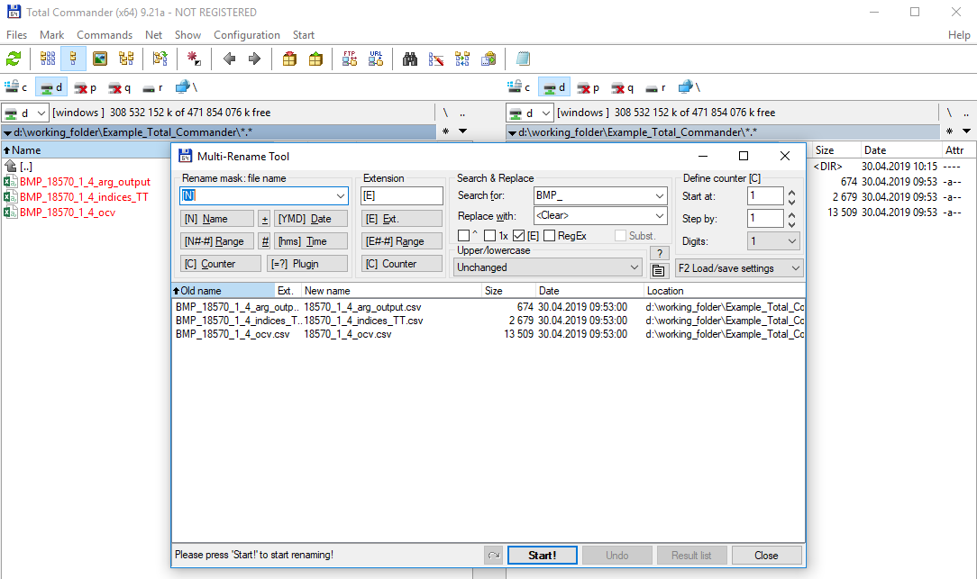
6. Delete prefix in Total Commander
  Data delivery
1. Copy files to be submitted to a special folder
2. Mark all the files
3. Files -> Multi-Rename Tool -> Search & Replace “BMP_”

Slide 30
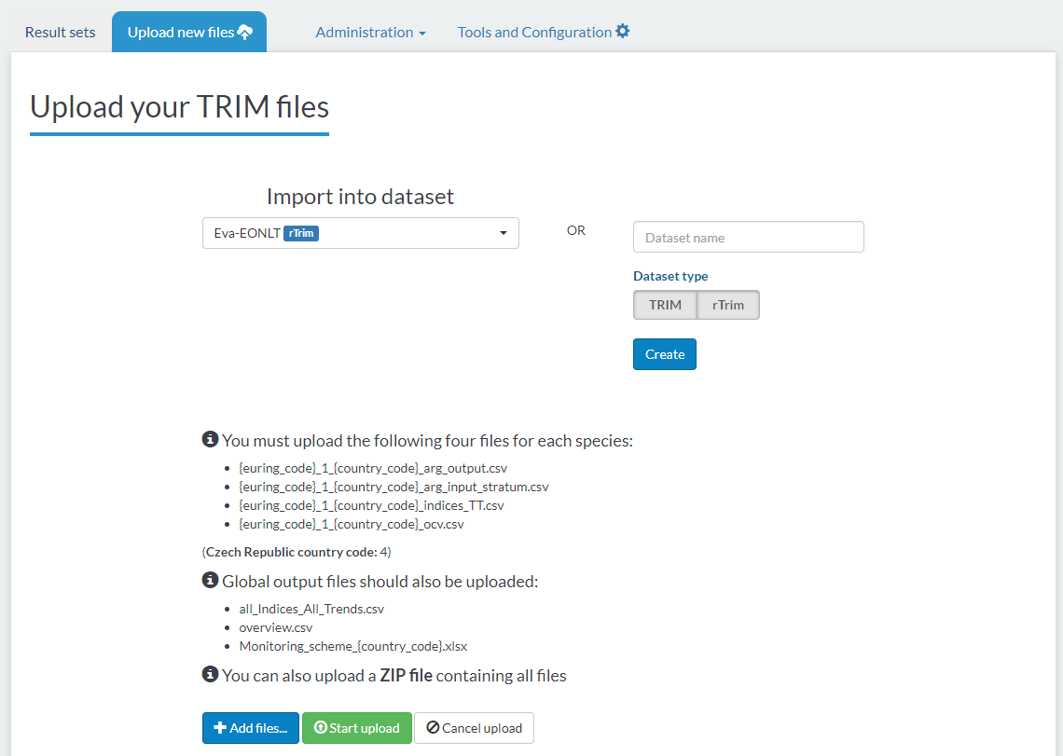
Data submission in the On-line tool
  Data delivery
ONLT for TRIM
& RTRIM-shell outputs
  https://data.pecbms.info/user/login
  Login and password same as former year
ONLT Tutorial
  https://pecbms.info/methods/software/birdstats/

Slide 31

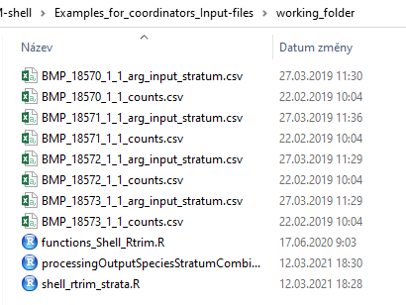
7. Example to practise RTRIM-shell
  RTRIM-shell examples

Slide 32
7. Example to practise RTRIM-shell
  RTRIM-shell examples

Slide 33
7. Example to practise RTRIM-shell
  RTRIM-shell examples
  & Problems
Reserve a day before the Webinar
Run example files
run RTRIM-shell with your own data
  Start with 2 or 3 most common species.
    Turdus merula 11870 and Fringilla coelebs 16360
  Copy the example files you’ve got from me
  Fill the data files with your own data.
    Case sensitivity
    Different formatting in your computer

Slide 34
R for beginners
  R for beginners
Useful links for downloads and R tutorials
Webpage for R download
  https://www.r-project.org/
Webpage for RStudio download
  https://rstudio.com/products/rstudio/download/#download
On-line presentation on R & RStudio installation
  https://slideplayer.com/slide/13757425/
Introduction to R & RStudio – Tutorial
  https://www.youtube.com/watch?v=BvKETZ6kr9Q
Manual how to use the scripts and their description is written right at each script

Slide 35
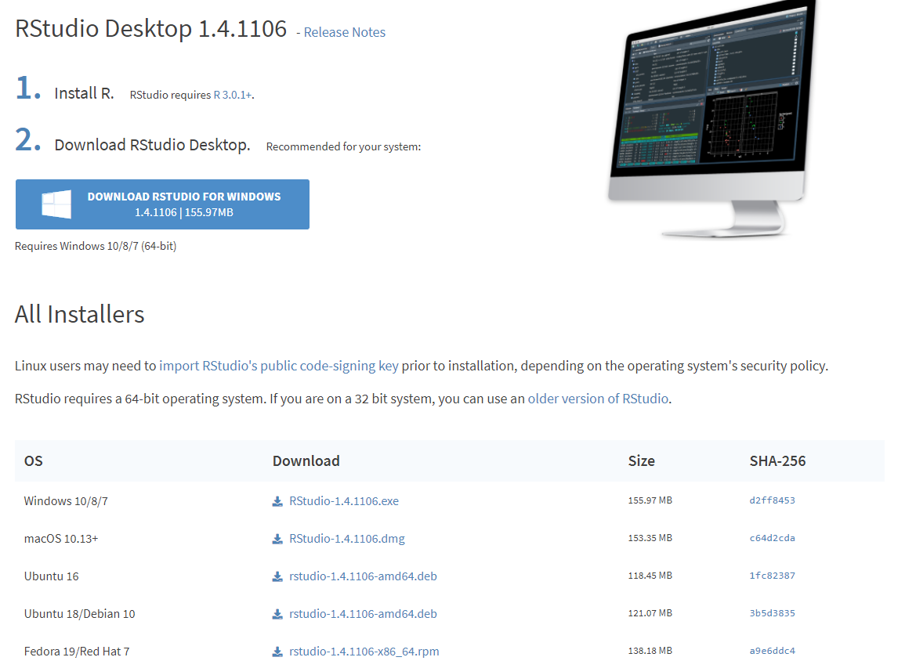
RStudio download
  R for beginners
Webpage for RStudio download
  https://rstudio.com/products/rstudio/download/#download

Slide 36
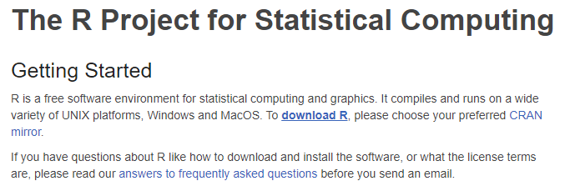
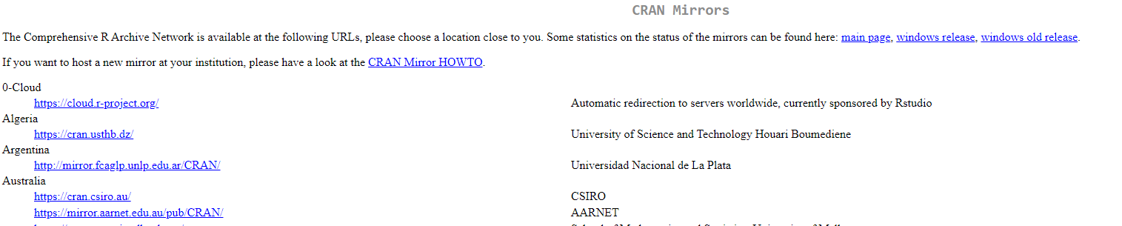
R download and setting for RTRIM-shell
  R for beginners
https://www.r-project.org/

Slide 37
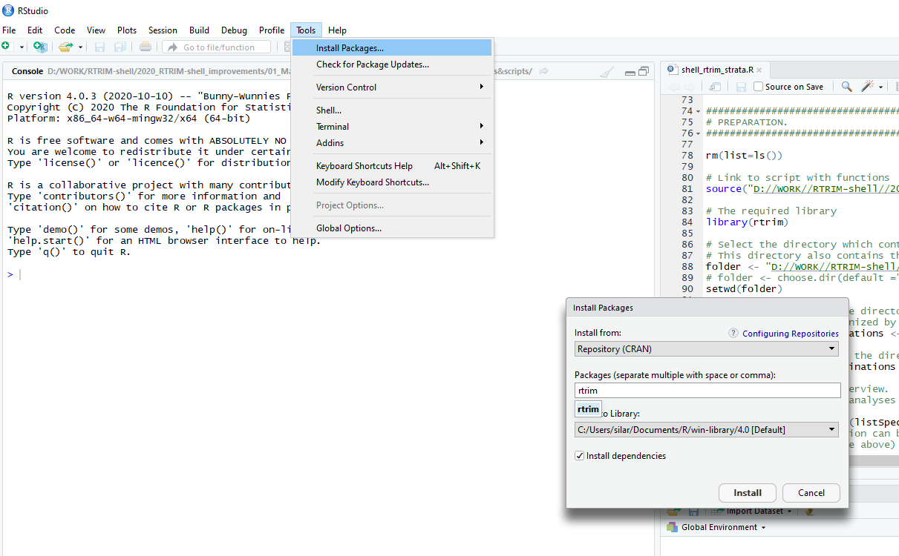
RTRIM package download for RTRIM-shell
  R for beginners
In both, R and Rstudio go to bookmark Tools -> Install Packages -> write rtrim to the popping window and press Install

Slide 38
Most usual problems
  R for beginners
Case sensitivity!!!
Path set wrong
  Copy path from your Browser, do not write it by hand
  Try all four versions of slashes:
    “D:/working_folder/functions_Shell_Rtrim.R”
    “D://working_folder//functions_Shell_Rtrim.R”
    “D:\working_folder\functions_Shell_Rtrim.R”
    “D:\\working_folder\\functions_Shell_Rtrim.R”
  If an error message appears, check if all the paths are replaced
  Read the Manuals in scripts carefully, most of answers will be found in the scripts
Unknown value marked NA
  TRIM used “-1” x RTRIM-shell uses NA!!!
  Ensure yourself that NA is everywhere and not -1
Use google
  If an Error message appears, copy paste this message to Google and there will be answer

Slide 39
Most usual problems
  R for beginners
Case sensitivity!!!
Path set wrong
  Copy path from your Browser, do not write it by hand
  Try all four versions of slashes:
    “D:/working_folder/functions_Shell_Rtrim.R”
    “D://working_folder//functions_Shell_Rtrim.R”
    “D:\working_folder\functions_Shell_Rtrim.R”
    “D:\\working_folder\\functions_Shell_Rtrim.R”
  If an error message appears, check if all the paths are replaced
  Read the Manuals in scripts carefully, most of answers will be found in the scripts
Unknown value marked NA
  TRIM used “-1” x RTRIM-shell uses NA!!!
  Ensure yourself that NA is everywhere and not -1
Use google
  If an Error message appears, copy paste this message to Google and there will be answer

Slide 40
Good luck!
Do not hesitate to ask. ☺

